Slide 1
Self-diffusion NMR
NMR and MRI Application in Biotechnology

Slide 2
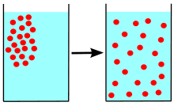
Diffusion

Slide 3
Diffusion
Molecules or ions move through the surrounding media
Rotational motion
Translational motion

Slide 4
Definition
Diffusion is the random translational motion of molecules or ions through the surrounding media that is driven by internal thermal energy.

Slide 5
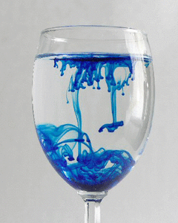
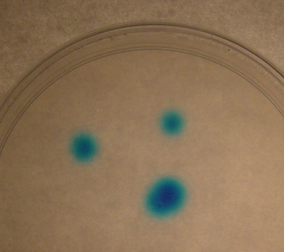
Diffusion
This is NOT a diffusion
This IS diffusion

Slide 6
Diffusion
Diffusion is the basic mechanism by which molecules are distributed in space.
It is considered to play a central role in any chemical reaction since the reacting species have to collide before the reaction can occur.

Slide 7
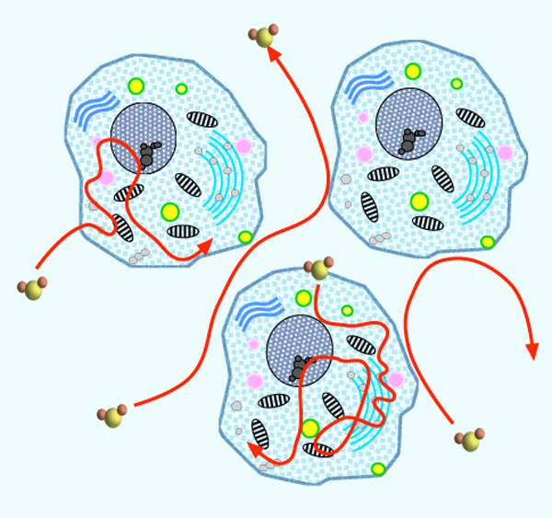
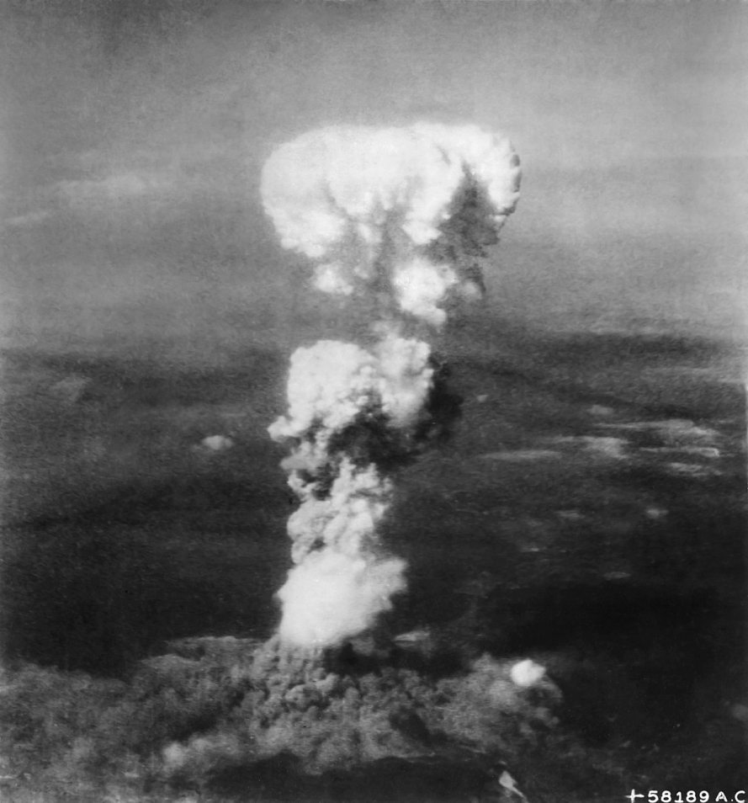
Diffusion

Slide 8
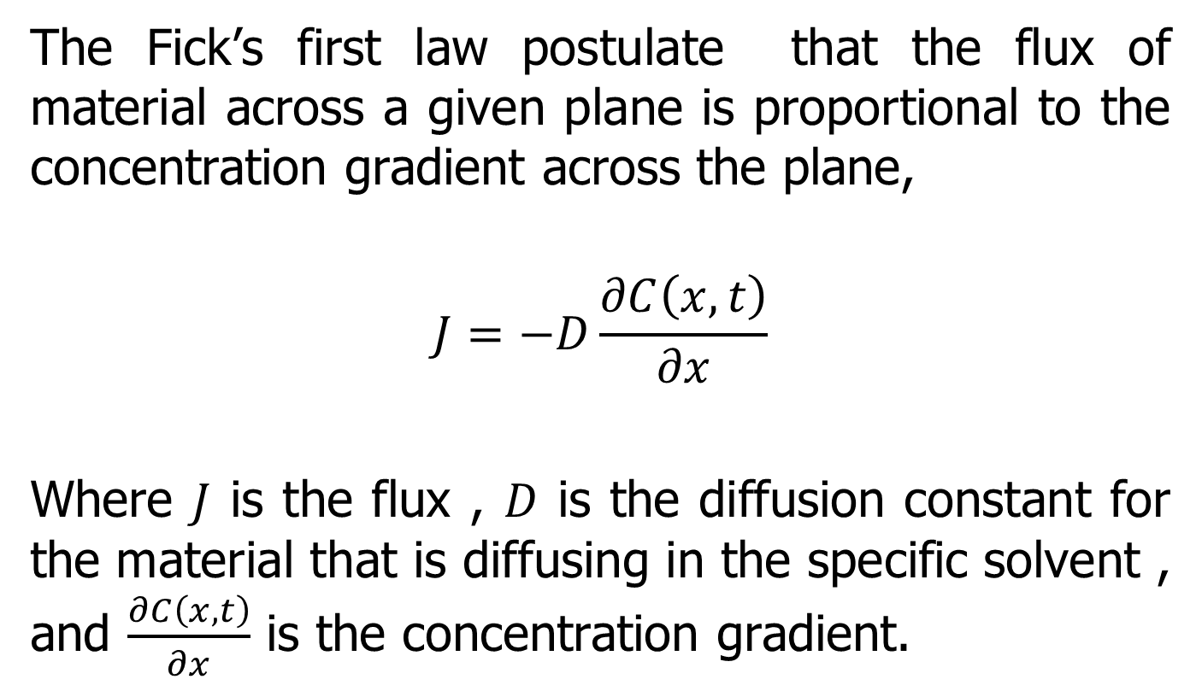
Mathematics of Diffusion
The Fick’s first law postulate that the flux of material across a given plane is proportional to the concentration gradient across the plane,
$$J=−D\frac{∂C\left(x,t\right)}{∂x}$$
Where $J$ is the flux , $D$ is the diffusion constant for the material that is diffusing in the specific solvent , and $\frac{∂C\left(x,t\right)}{∂x}$ is the concentration gradient.

Slide 9
Mathematics of Diffusion
The negative sign of the right side of the equation indicates that the impurities are flowing in the direction of lower concentration.
Fick’s First law does not consider the fact that the gradient and local concentration of the impurities in a material decreases with in increase in time.

Slide 10
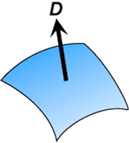

Diffusion Coefficient (D)
The diffusion constant D represents particle flux through a surface over a period of time
D is expressed in units of $\frac{{length}^{2}}{time}$

Slide 11
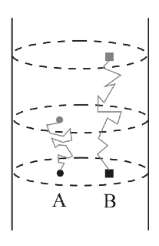
Diffusion NMR
We can measure diffusion by NMR if we can map the location of a molecule in solution and how this varies as a function of time
Notes:
Benchmark – typical small molecules have D ~ 1-10x10⁻¹⁰ m²s⁻¹

Slide 12
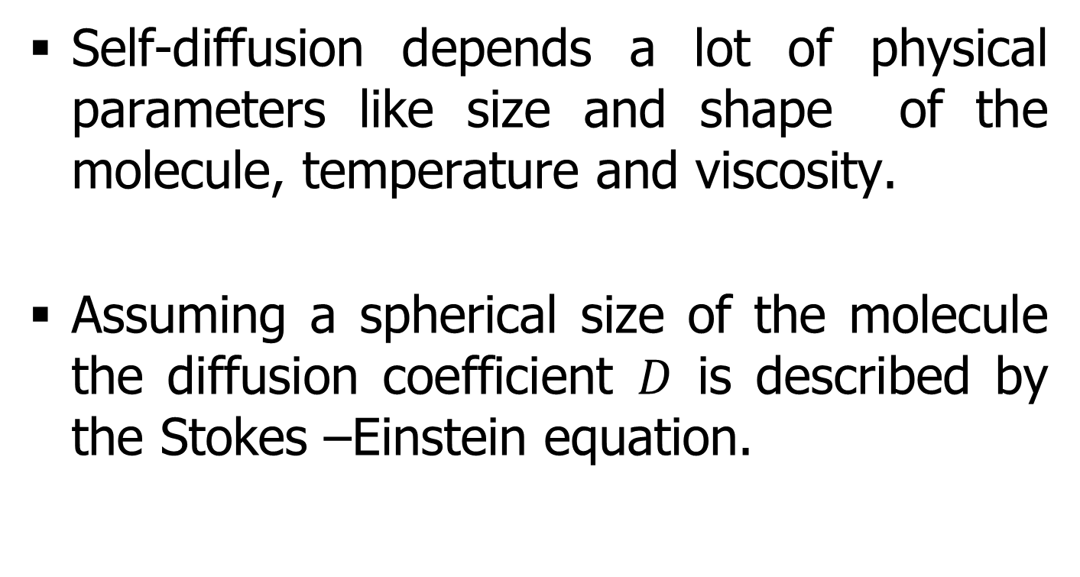
Mathematics of Diffusion
Self-diffusion depends a lot of physical parameters like size and shape of the molecule, temperature and viscosity.
Assuming a spherical size of the molecule the diffusion coefficient $D$ is described by the Stokes –Einstein equation.

Slide 13
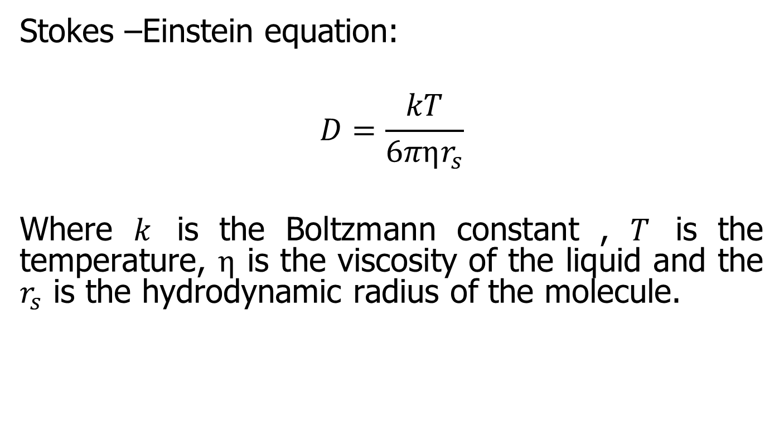
Mathematics of Diffusion
Stokes –Einstein equation:
$$D=\frac{kT}{6πηr_{s}}$$
Where $k$ is the Boltzmann constant , $T$ is the temperature, $η$ is the viscosity of the liquid and the $r_{s}$ is the hydrodynamic radius of the molecule.

Slide 14
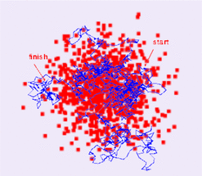
Diffusion as a "random walk"

Slide 15
Diffusion NMR
NMR technique is suitable to study static properties of the matter (ie. structure) and dynamic properties like self-diffusion, flow and relaxation.
Self-diffusion data provide detailed information about molecular organization and phase structure.
Self-diffusion rates are quite sensitive to structural changes and to binding and association phenomena.
Experimental self-diffusion values are directly related to molecular displacement.

Slide 16
What can we study with Diffusion?
Analysis of Mixtures
Intra-molecular interactions
Supra and biomolecular complexes
Affinity
Chemical exchange

Slide 17
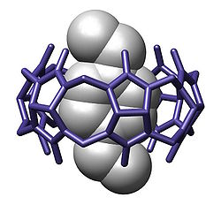
Diffusion Applications
Aggregation
Slower Diffusion as molecules self-aggregate
Host-guest formation
Binding of small “guest” molecules within larger host leads to slower diffusion
Supramolecular chemistry
Assessment of molecular size

Slide 18
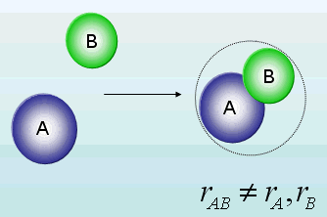
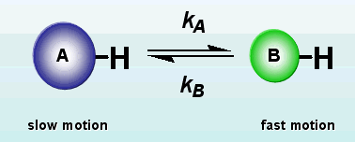
Complexes and Exchange
Complexes
Exchange

Slide 19
Diffusion NMR
The diffusion NMR technique is often referred to as Self-Diffusion (SD)-NMR or Diffusion Ordered Spectroscopy (DOSY).
This is achieved by combining radio-frequency pulses as used in routine NMR spectroscopy with magnetic field gradients that encode spatial information.

Slide 20
Diffusion NMR
The simplest form of the pulsed gradient diffusion experiment is called the pulsed field gradient echo (PGSE).
In the PGSE, the magnetization is excited with a 90° radiofrequency pulse then using a magnetic field gradient pulse.
After a period of Δ/2 a 180°radiofrequency pulse inverts the dispersed magnetization such that after a period of Δ the magnetization is the negative of what it was following the gradient pulse. At this point, a second gradient pulse is applied to refocus the signal.

Slide 21
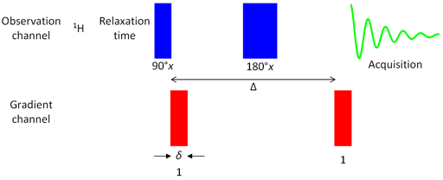
Diffusion NMR
Pulse sequence for gradient PGSE.

Slide 22
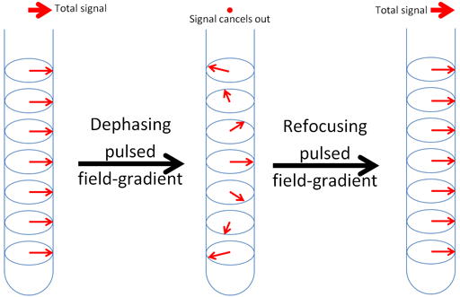
Diffusion NMR
Effect of a magnetic field gradient pulse.

Slide 23
Diffusion NMR
Refocusing is only achieved for those nuclei that have not moved significantly up or down.
Diffusion causes some of the nuclei to move away from where their signals can be refocused thereby reducing the intensity of the resulting signal.

Slide 24
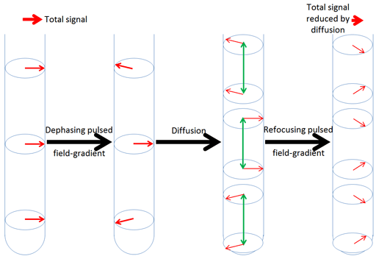
Diffusion NMR
Effect of the diffusion combined with magnetic field gradient pulses.

Slide 25
Diffusion NMR
The more intense and the longer the magnetic field gradient pulse, the more spatially selective it is and weaker is the resulting signal.
The intensity and duration of the magnetic field gradient pulse determine the distance that a nucleus can diffuse and still yield a signal.

Slide 26
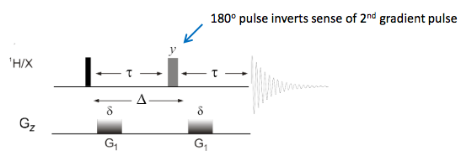
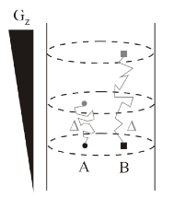
Diffusion NMR
DOSY uses two PFG pulses separated by a diffusion time Δ
First PFG destroys (dephases) all signals
Second PFG acts in opposition to first & may recover (rephase) signals
IF NO MOVEMENT during Δ – FULL signal recovered
IF MOVEMENT OCCURS during Δ, signal is NOT fully rephased leading to loss of signal

Slide 27
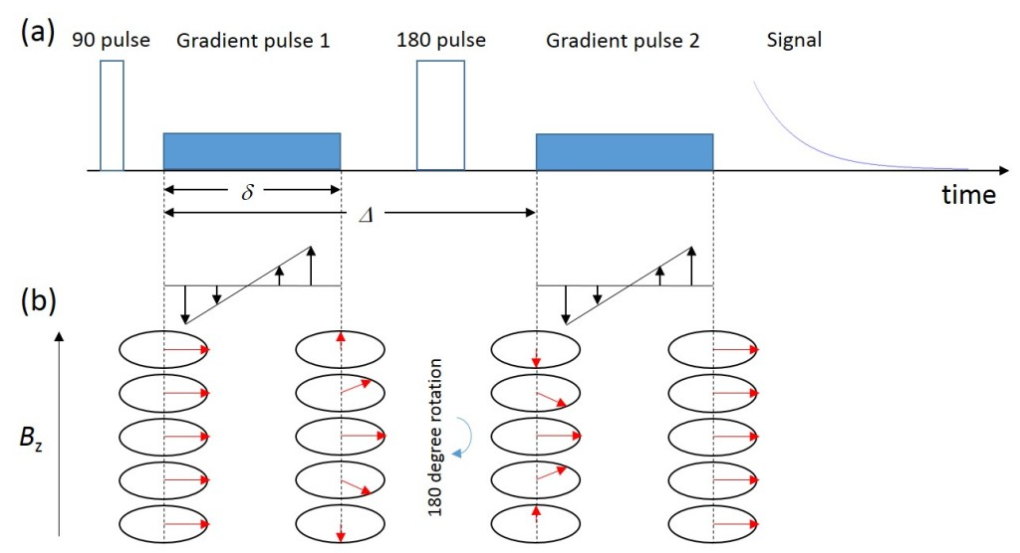
Diffusion NMR

Slide 28
Diffusion NMR
Movement of molecules during Δ leads to LOSS of resonance intensity.
The pulse sequence is repeated (usually 32 times) incrementing the gradient strength and keeping the delays constant.

Slide 29
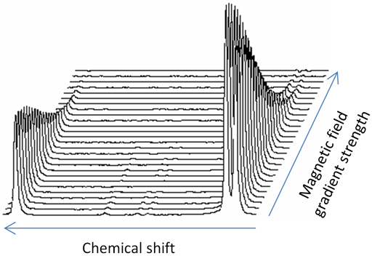
Diffusion NMR
Diffusion spectrum

Slide 30
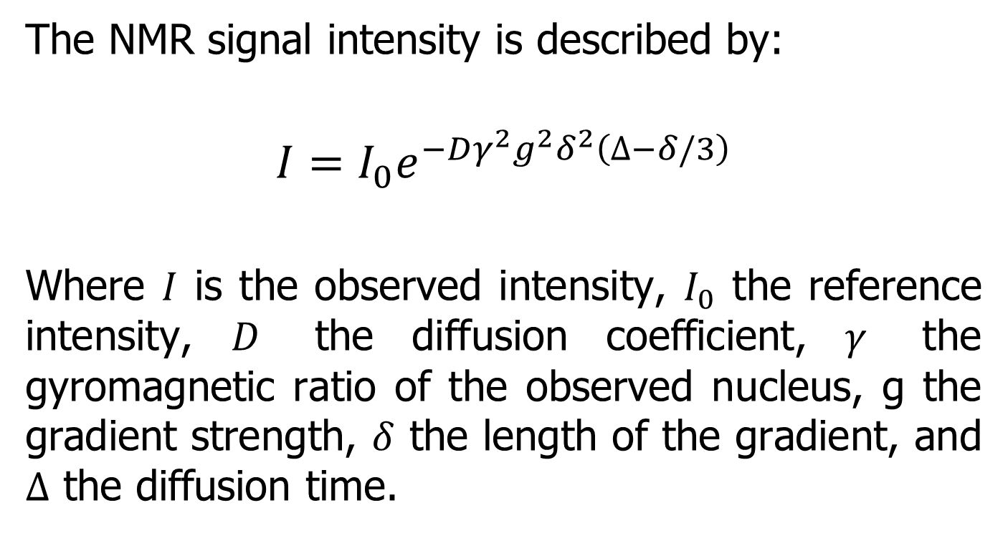
Diffusion NMR
The NMR signal intensity is described by:
$$I=I_{0}e^{−Dγ^{2}g^{2}δ^{2}\left(∆−δ/3\right)}$$
Where $I$ is the observed intensity, $I_{0}$ the reference intensity, $D$ the diffusion coefficient, $γ$ the gyromagnetic ratio of the observed nucleus, g the gradient strength, $δ$ the length of the gradient, and $∆$ the diffusion time.

Slide 31
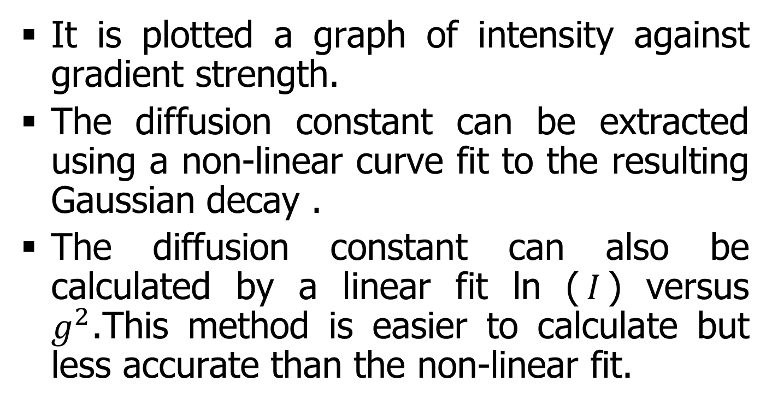
Diffusion NMR
It is plotted a graph of intensity against gradient strength.
The diffusion constant can be extracted using a non-linear curve fit to the resulting Gaussian decay .
The diffusion constant can also be calculated by a linear fit ln ($I$) versus $g^{2}$.This method is easier to calculate but less accurate than the non-linear fit.

Slide 32
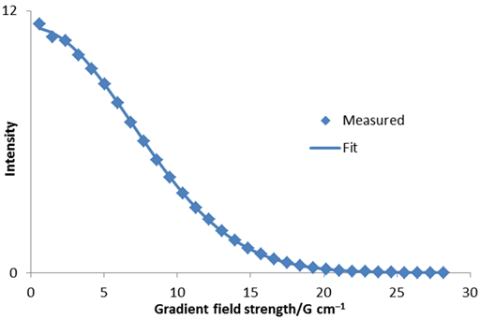
Diffusion NMR
Gaussian fit to diffusion peak intensity using non-linear fit

Slide 33
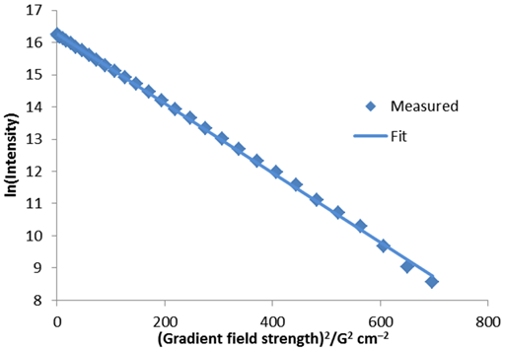
Diffusion NMR
Linear fit to diffusion peak intensity

Slide 34
In Summary: DOSY
Powerful method for the NMR analysis of many types of mixtures
Measure diffusion coefficients which reflect size and shape of molecular species
Applications: association constants, investigating aggregation, encapsulation, intermolecular interactions in multi-component systems and size and structure of unstable systems.

Slide 35
Contact Information
Prof. Zeev Wiesman: wiesman@bgu.ac.il
Maysa Resende: mteixeiraresende@gmail.com
Dr. Janna Abramovich: janna@bgu.ac.il
Shosh Kravchick: kravch@bgu.ac.il
Plant Lipid Biotechnology Lab phone number: 074-7795272

